Slide 1
Python Tutorial Series 2019 AstroPy Working with Images
Ph.D. Bruno C. Quint - bquint@gemini.edu
SUSD - GEMINI South, La Serena, Chile

Slide 2
Zen of Python
In [1]: import this
The Zen of Python, by Tim Peters
Beautiful is better than ugly.
Explicit is better than implicit.
Simple is better than complex.
Complex is better than complicated.
Flat is better than nested.
Sparse is better than dense.
Readability counts.
Special cases aren't special enough to break the rules.
Although practicality beats purity.
Errors should never pass silently.
Unless explicitly silenced.
In the face of ambiguity, refuse the temptation to guess.
There should be one-- and preferably only one --obvious way to do it.
Although that way may not be obvious at first unless you're Dutch.
Now is better than never.
Although never is often better than *right* now.
If the implementation is hard to explain, it's a bad idea.
If the implementation is easy to explain, it may be a good idea.
Namespaces are one honking great idea -- let's do more of those!

Slide 3
Previously...
Basics I
What is Python?
What will you need?
Python as a terminal
Python as a script
Types of variables
Basics II
Code Flow
Functions
Classes
Methods
Attributes
Sub-Classes
Basics III
(Re)using code
Modules
Packages
Python2 to Python3
External packages
Virtual Environments
Conda and Anaconda

Slide 4
Data Analysis and Visualization
DataViz 1
iPython / Jupyter
NumPy
MatPlotLib
2D Plots
DataViz 2
NumPy Tricks
Image Display
Image Analysis
Image Manipulation

Slide 5
AstroPy
Coordinated Packages
Affiliated Packages
astropy-core astroquery
astropy-healpix ccdproc
photutils regions
reproject specutils
APLpy Astro-SCRAPPY
astroML … ginga imexam linetools
PyVO … and 30 more!
https://www.astropy.org/affiliated/index.html

Slide 6
AstroPy
Open Source
Community driven
Mature
API Changes
Limited Support
Coordinated Packages
Affiliated Packages
astropy-core astroquery
astropy-healpix ccdproc
photutils regions
reproject specutils
APLpy Astro-SCRAPPY
astroML … ginga imexam linetools
PyVO … and 30 more!
https://www.astropy.org/affiliated/index.html

Slide 7
AstroPy
FITS Input/Output
Image Display
Image Analysis with imexam
Photometry with photutils

Slide 8
AstroPy
reading data
from astropy.io import fits
data = fits.getdata("simple_image.fits")
print(data.__class__)
<class 'numpy.ndarray'>
print(data.shape)
(2149, 3245)
getdata
Fits to NumPy Array
Check __class__ attribute
Access shape

Slide 9
AstroPy
reading header
from astropy.io import fits
header = fits.getheader("simple_image.fits")
print(header.__class__)
<class 'astropy.io.fits.header.Header'>
print(header["INSTRUME"])
GMOS-S
print(list(header.keys()))
['SIMPLE', 'BITPIX', 'NAXIS', 'EXTEND’, ...]
getheader
Reads
metadata/header
Check __class__ attribute
Access info as dictionary
List all keys (cards)

Slide 10
AstroPy
Header Data Unit Lists
from astropy.io import fits
hdul = fits.open("simple_image.fits")
print(hdul.__class__)
<class 'astropy.io.fits.hdu.hdulist.HDUList’>
Header Data Unit Lists
Primary HDU
Image HDU
Table HDU
Header
Header
Header
Data
Data
Table

Slide 11
AstroPy
Header Data Unit Lists
from astropy.io import fits
hdul = fits.open("simple_image.fits")
hdul.info()
Filename: simple_image.fits
No. Name Ver Type Cards Dimensions Format
0 PRIMARY 1 PrimaryHDU 252 ()
1 SCI 1 ImageHDU 159 (3245, 2149) float32
2 VAR 1 ImageHDU 159 (3245, 2149) float32
3 DQ 1 ImageHDU 159 (3245, 2149) int16
4 OBJMASK 1 ImageHDU 159 (3245, 2149) uint8
5 OBJCAT 1 BinTableHDU 128 1756R x 43C [J,...]

Slide 12
AstroPy
Header Data Unit Lists
from astropy.io import fits
hdul = fits.open("multi_extension_image.fits")
hdul.info()
Filename: multi_extension_image.fits
No. Name Ver Type Cards Dimensions Format
0 PRIMARY 1 PrimaryHDU 252 ()
1 -1 ImageHDU 324 (288, 2112) int16
2 -1 ImageHDU 288 (288, 2112) int16
3 -1 ImageHDU 252 (288, 2112) int16
4 -1 ImageHDU 252 (288, 2112) int16
...

Slide 13
AstroPy
Show Images
from astropy.io import fits
hdul = fits.open("simple_image.fits")
sci = hdul[0]
sci = hdul["SCI"]

Slide 14
AstroPy
Show Images
from astropy.io import fits
hdul = fits.open("simple_image.fits")
sci = hdul[0]
sci = hdul["SCI"]
from matplotlib import pyplot as plt
fig, ax = plt.subplots(num="My First Image")
ax.imshow(sci.data)
plt.show()

Slide 15
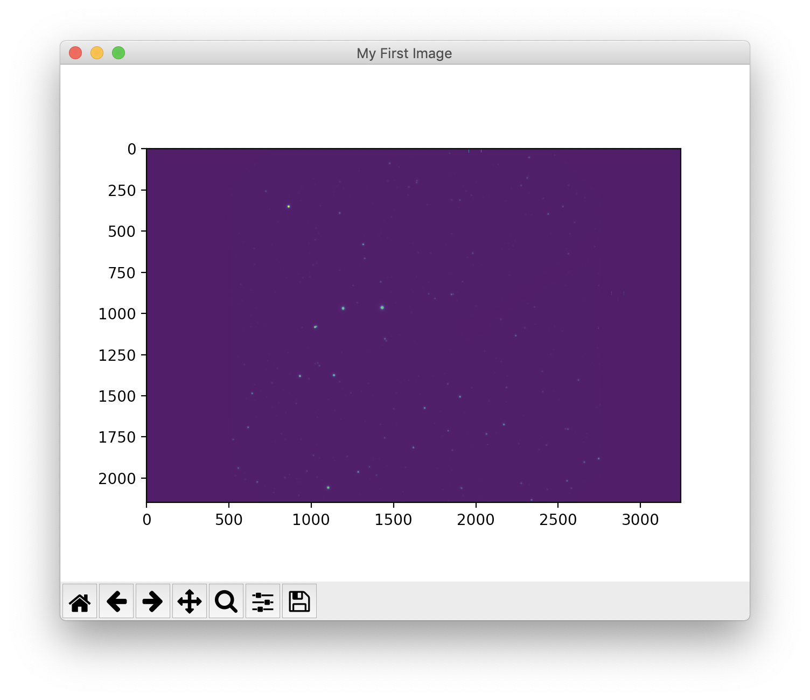
AstroPy
Show Images
from astropy.io import fits
hdul = fits.open("simple_image.fits")
sci = hdul[0]
sci = hdul["SCI"]
from matplotlib import pyplot as plt
fig, ax = plt.subplots(num="My First Image")
ax.imshow(sci.data)
plt.show()

Slide 16
AstroPy
Show Images
fig, ax = plt.subplots(num="My image with more details")
ax.imshow(sci.data, origin="lower", vmin=1e1, vmax=1e4)
ax.set_xlabel("x [px]")
ax.set_ylabel("y [px]")
ax.set_title("My Image")
ax.grid("-", color="white", alpha=0.1)
plt.show()

Slide 17
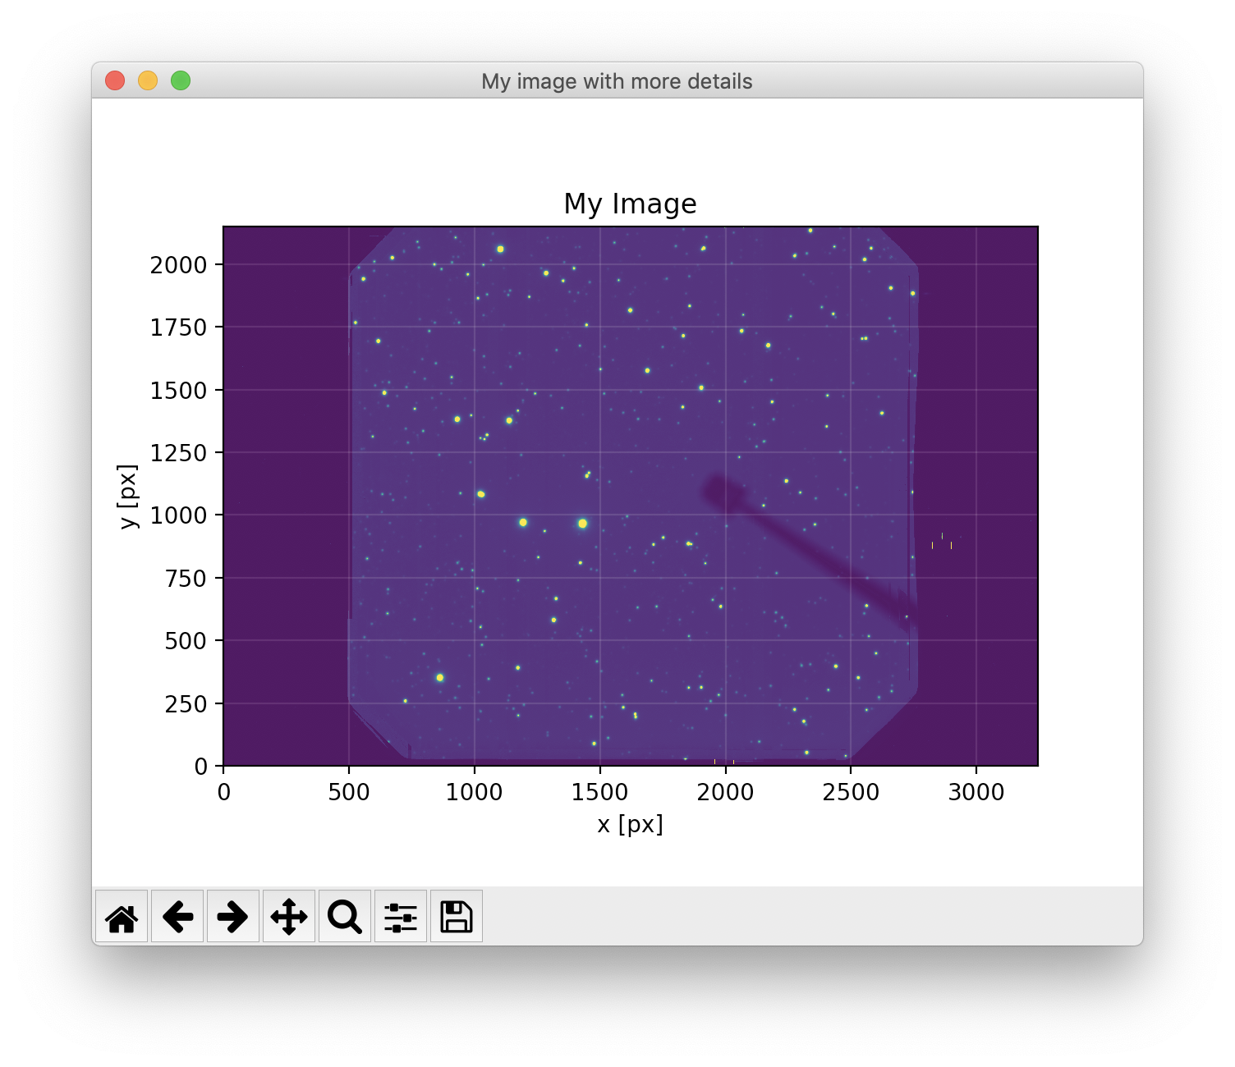
AstroPy
Show Images
fig, ax = plt.subplots(num="My image with more details")
ax.imshow(sci.data, origin="lower", vmin=1e1, vmax=1e4)
ax.set_xlabel("x [px]")
ax.set_ylabel("y [px]")
ax.set_title("My Image")
ax.grid("-", color="white", alpha=0.1)
plt.show()

Slide 18
AstroPy
Image Normalization
from astropy import visualization as vis
norm_factor = vis.ImageNormalize(
sci.data,
interval=vis.ZScaleInterval(),
stretch=vis.LinearStretch())
...
ax.imshow(sci.data, origin="lower", norm=norm_factor)
...

Slide 19
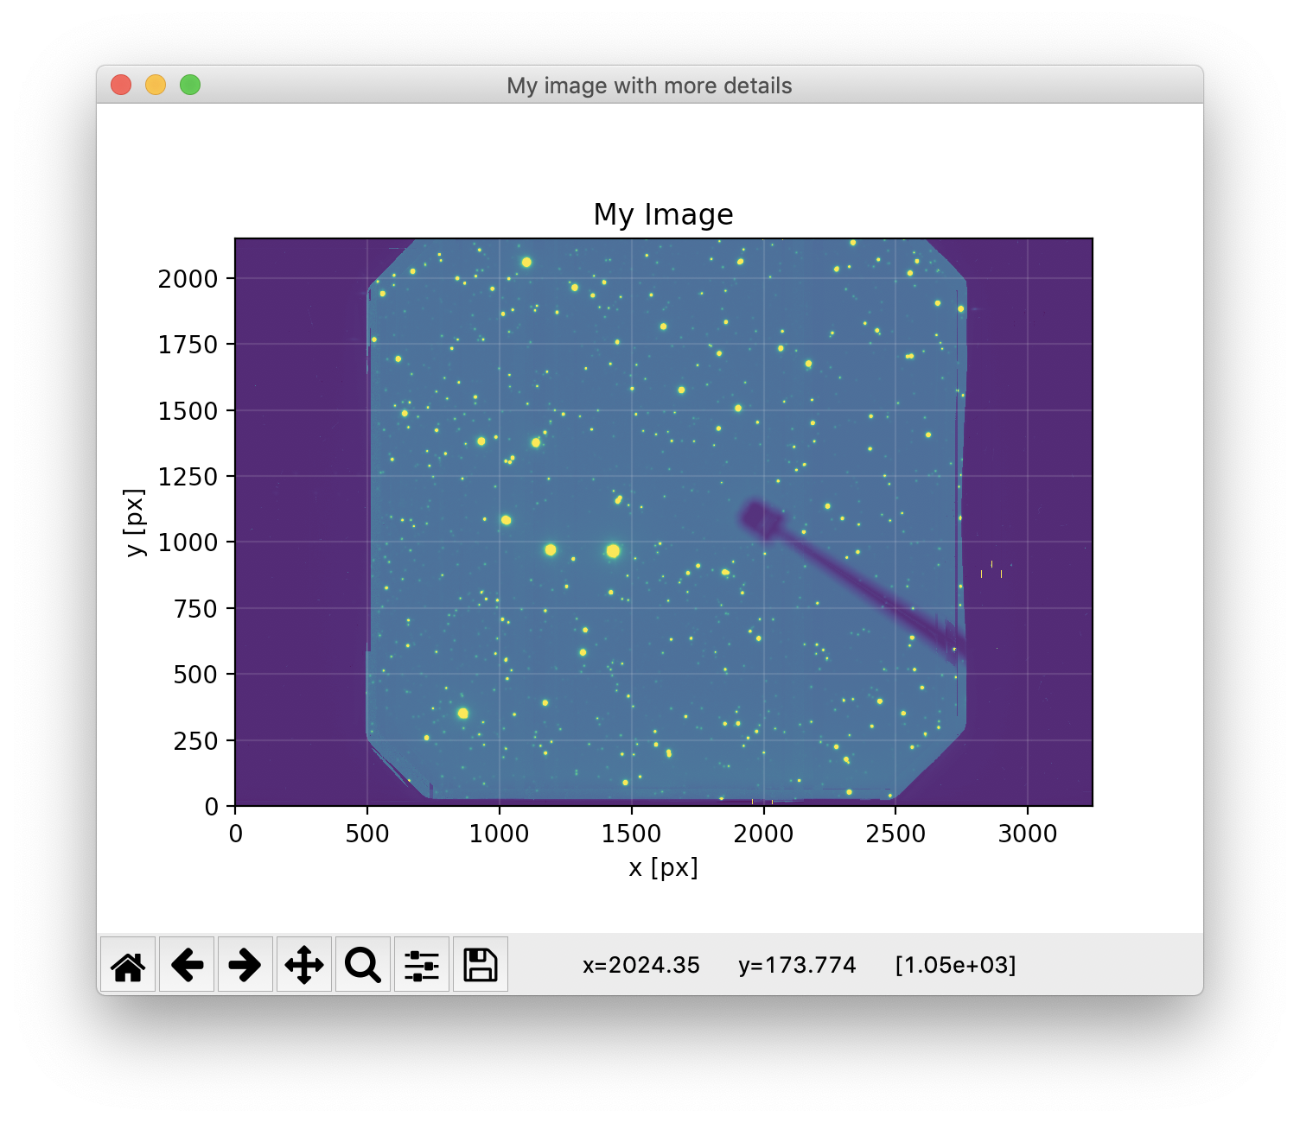
AstroPy
Image Normalization
from astropy import visualization as vis
norm_factor = vis.ImageNormalize(
sci.data,
interval=vis.ZScaleInterval(),
stretch=vis.LinearStretch())
...
ax.imshow(sci.data, origin="lower", norm=norm_factor)
...

Slide 20
AstroPy
Bad Data
from copy import copy
colormap = copy(plt.cm.viridis)
colormap.set_bad(color="Red")
dq = hdul["DQ"]
import numpy.ma as ma
masked_data = ma.masked_where(dq.data != 0, sci.data)
...
ax.imshow(masked_data, origin="lower", cmap=colormap)
...

Slide 21
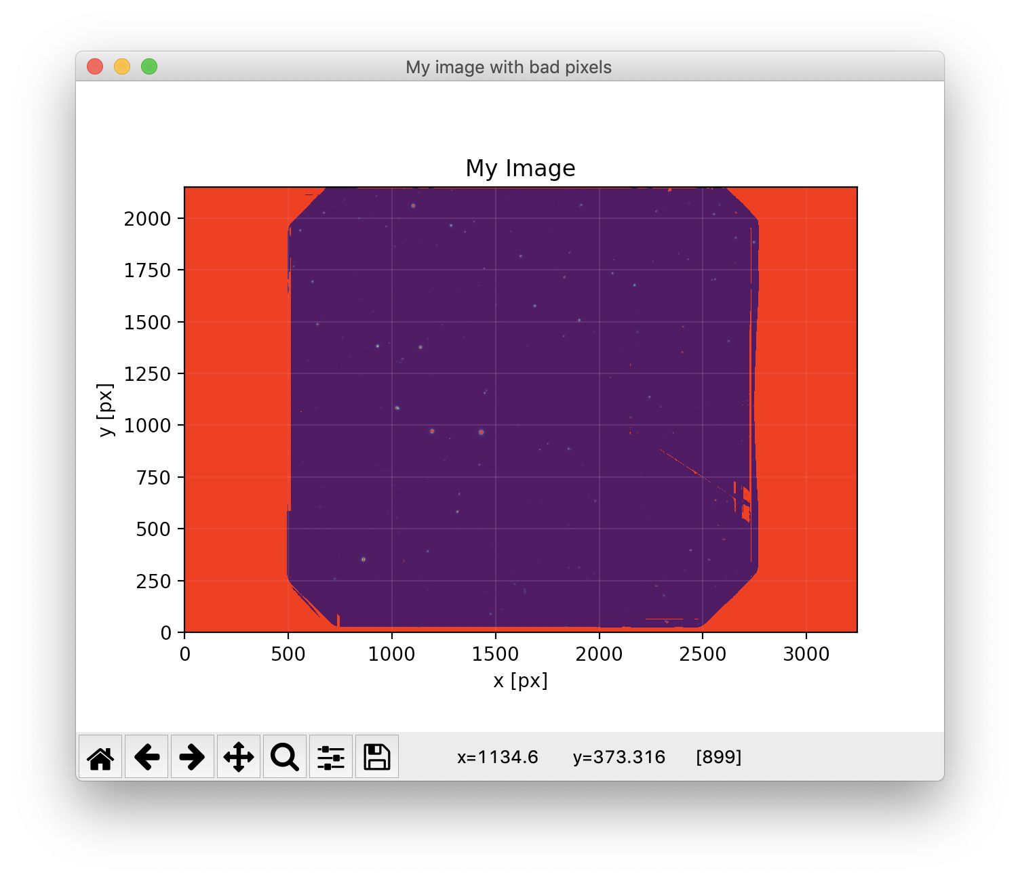
AstroPy
Bad Data
from copy import copy
colormap = copy(plt.cm.viridis)
colormap.set_bad(color="Red")
dq = hdul["DQ"]
import numpy.ma as ma
masked_data = ma.masked_where(dq.data != 0, sci.data)
...
ax.imshow(masked_data, origin="lower", cmap=colormap)
...

Slide 22
AstroPy
Bad Data and Normalization
...
ax.imshow(masked_data, origin="lower", cmap=colormap,
vmin=norm_factor.vmin, vmax=norm_factor.vmax)
...

Slide 23
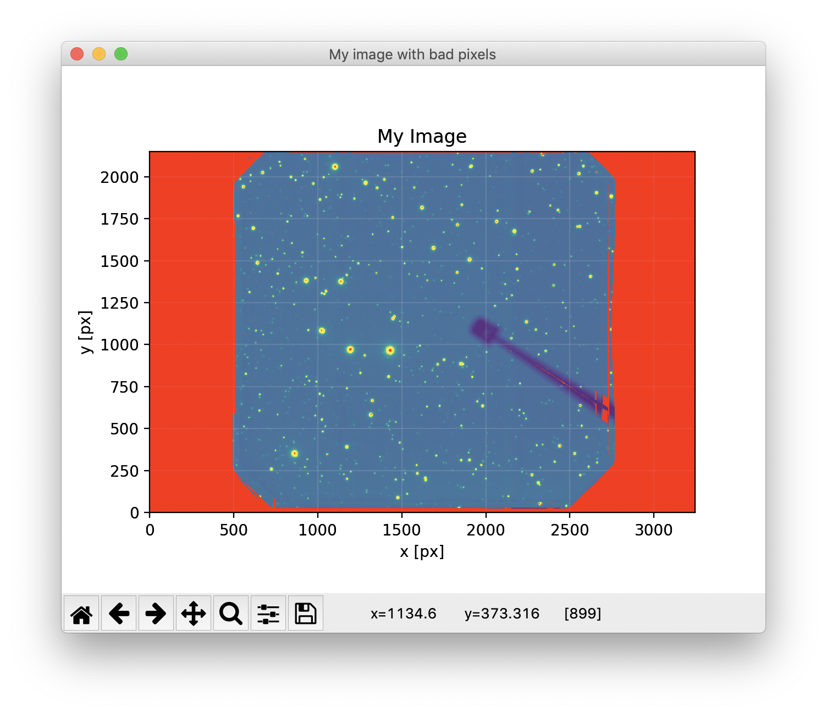
AstroPy
Bad Data and Normalization
...
ax.imshow(masked_data, origin="lower", cmap=colormap,
vmin=norm_factor.vmin, vmax=norm_factor.vmax)
...

Slide 24
AstroPy
World Coordinates
from astropy.wcs import WCS
from astropy.io import fits
from astropy.utils.data import get_pkg_data_filename
filename = get_pkg_data_filename('galactic_center/gc_msx_e.fits')
hdu = fits.open(filename)[0]
wcs = WCS(hdu.header)

Slide 25
AstroPy
World Coordinates
fig, ax = plt.subplots(num="Using WCS (2)",
subplot_kw={"projection": wcs})
ax.imshow(hdu.data, origin="lower", cmap=colormap,
vmin=-2.e-5, vmax=2.e-4,)
ax.set_xlabel('Galactic Longitude')
ax.set_ylabel('Galactic Latitude')
ax.set_title("My Image")
ax.grid("-", color="white", alpha=0.1)
plt.show()

Slide 26
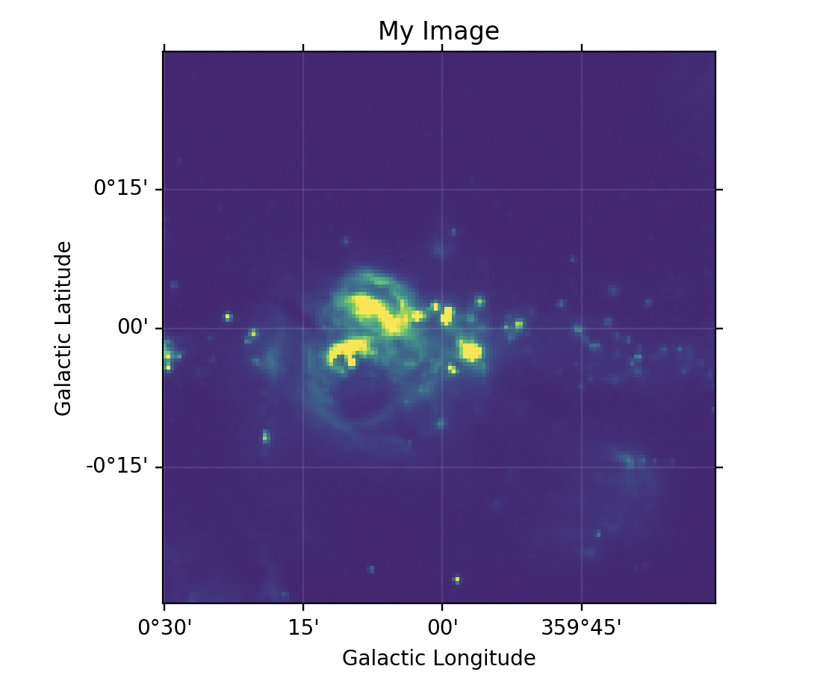
AstroPy
World Coordinates
fig, ax = plt.subplots(num="Using WCS (2)",
subplot_kw={"projection": wcs})
ax.imshow(hdu.data, origin="lower", cmap=colormap,
vmin=-2.e-5, vmax=2.e-4,)
ax.set_xlabel('Galactic Longitude')
ax.set_ylabel('Galactic Latitude')
ax.set_title("My Image")
ax.grid("-", color="white", alpha=0.1)
plt.show()

Slide 27
AstroPy
World Coordinates
from astropy.wcs import WCS
wcs = WCS(sci.header)
plt.figure(num="Image with WCS")
ax = plt.subplot(projection=wcs)
ax.imshow(sci.data, origin="lower)
ax.coords.grid(True, color="white", ls="solid")
ax.coords[0].set_axislabel("Right Ascention (J2000)")
ax.coords[1].set_axislabel("Declination (J2000)")
plt.show()

Slide 28
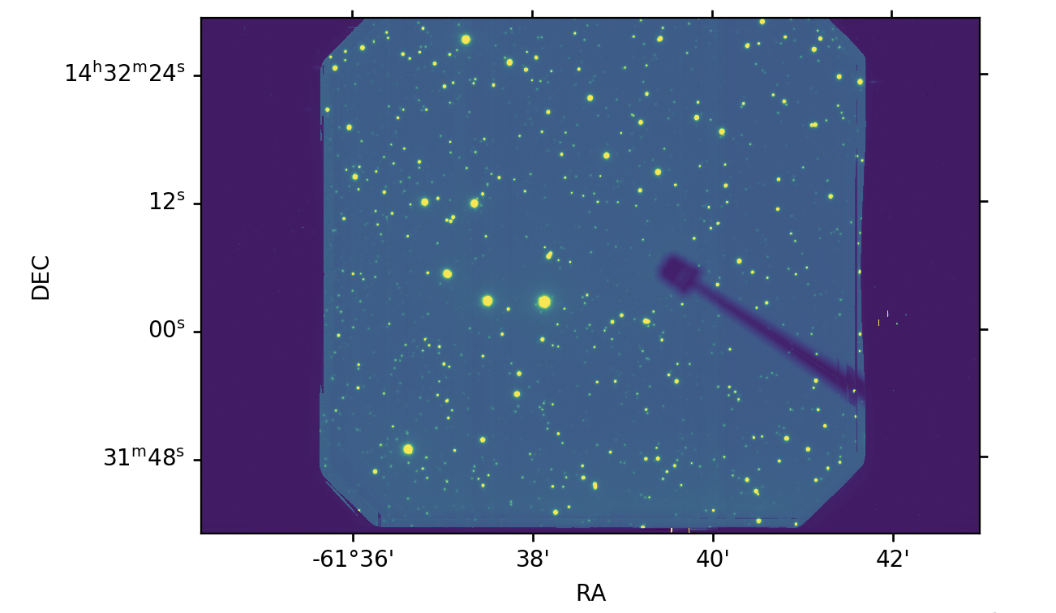
AstroPy
World Coordinates
from astropy.wcs import WCS
wcs = WCS(sci.header)
plt.figure(num="Image with WCS")
ax = plt.subplot(projection=wcs)
ax.imshow(sci.data, origin="lower)
ax.coords.grid(True, color="white", ls="solid")
ax.coords[0].set_axislabel("Right Ascention (J2000)")
ax.coords[1].set_axislabel("Declination (J2000)")
plt.show()

Slide 29
imexam
Issues and Limitations
Under heavy development
DS9 v7.4 - MacOS Mojave

Slide 30
imexam
Issues and Limitations
Under heavy development
DS9 v7.4 - MacOS Mojave
In [1]: import imexam
In [2]:
In [2]: w = imexam.connect()
In [3]: w.load_fits("data/simple_image.fits")
In [4]: w.imexam()

Slide 31
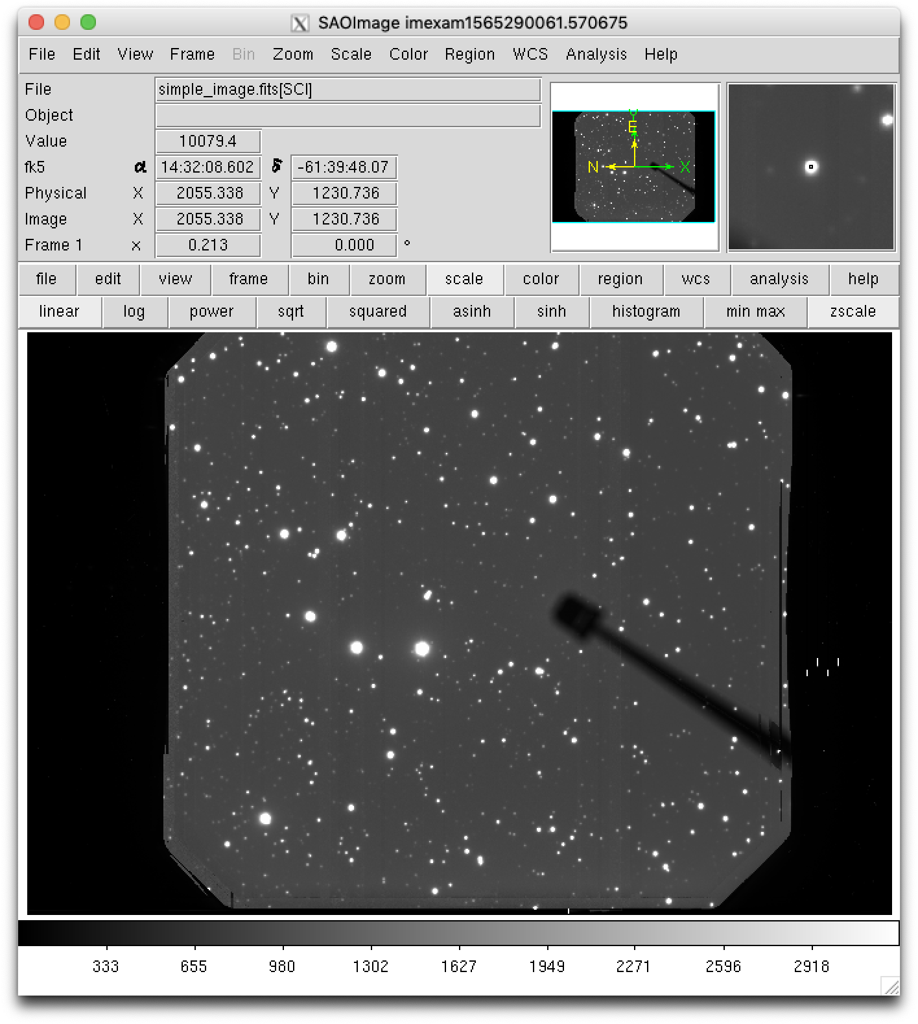
imexam
Issues and Limitations
Under heavy development
DS9 v7.4
In [1]: import imexam
In [2]:
In [2]: w = imexam.connect()
In [3]: w.load_fits("data/simple_image.fits")
In [4]: w.imexam()

Slide 32
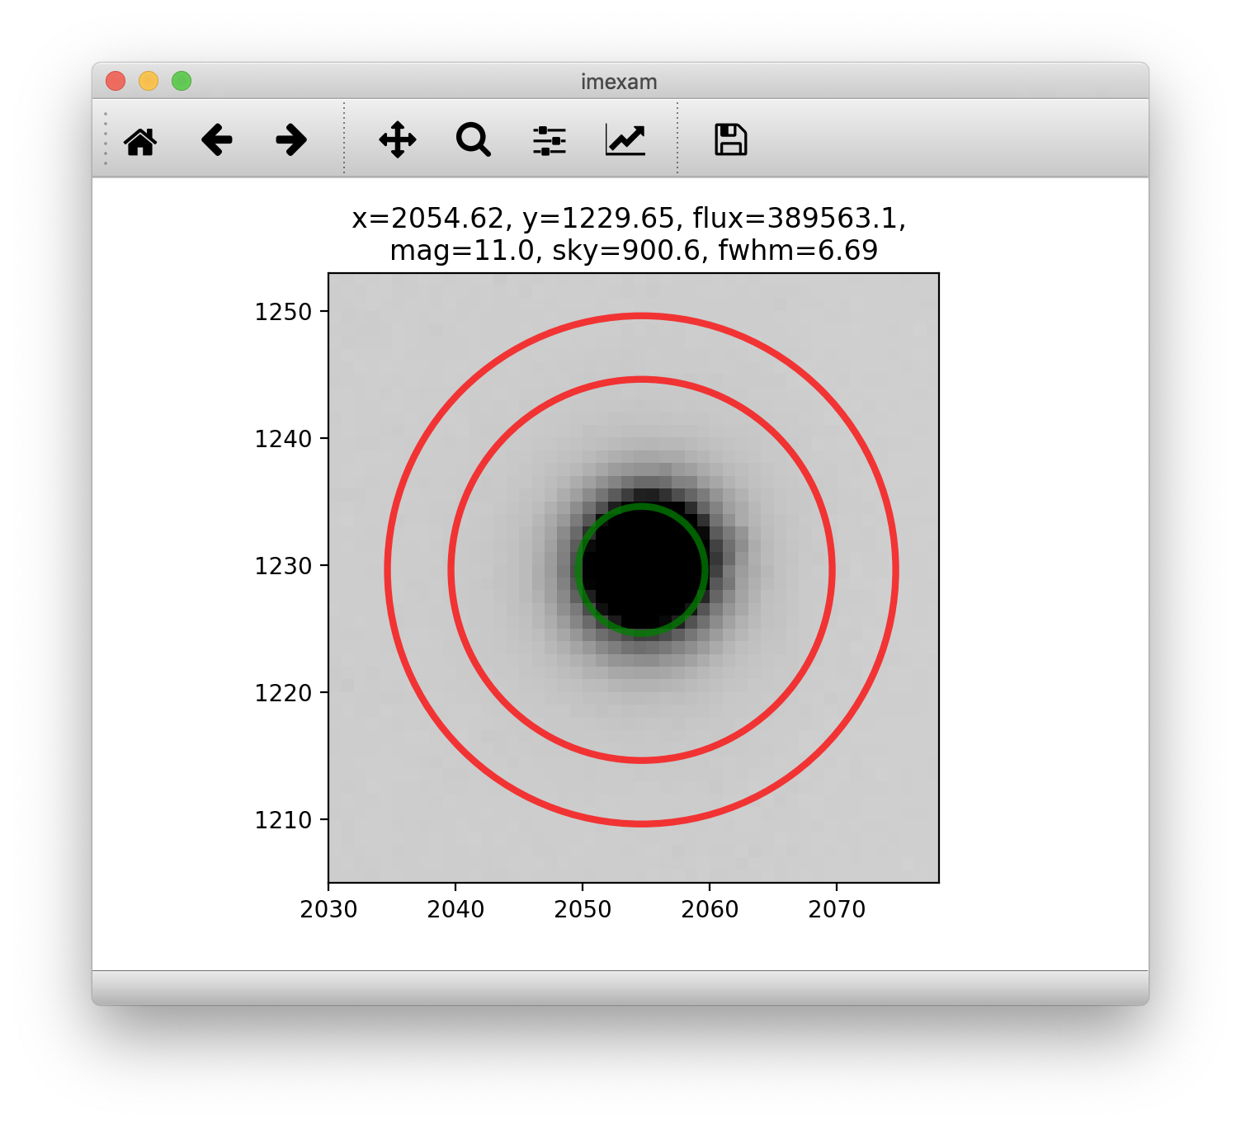
imexam
Issues and Limitations
Under heavy development
DS9 v7.4
In [1]: import imexam
In [2]:
In [2]: w = imexam.connect()
In [3]: w.load_fits("data/simple_image.fits")
In [4]: w.imexam()
Press A
Apperture sum

Slide 33
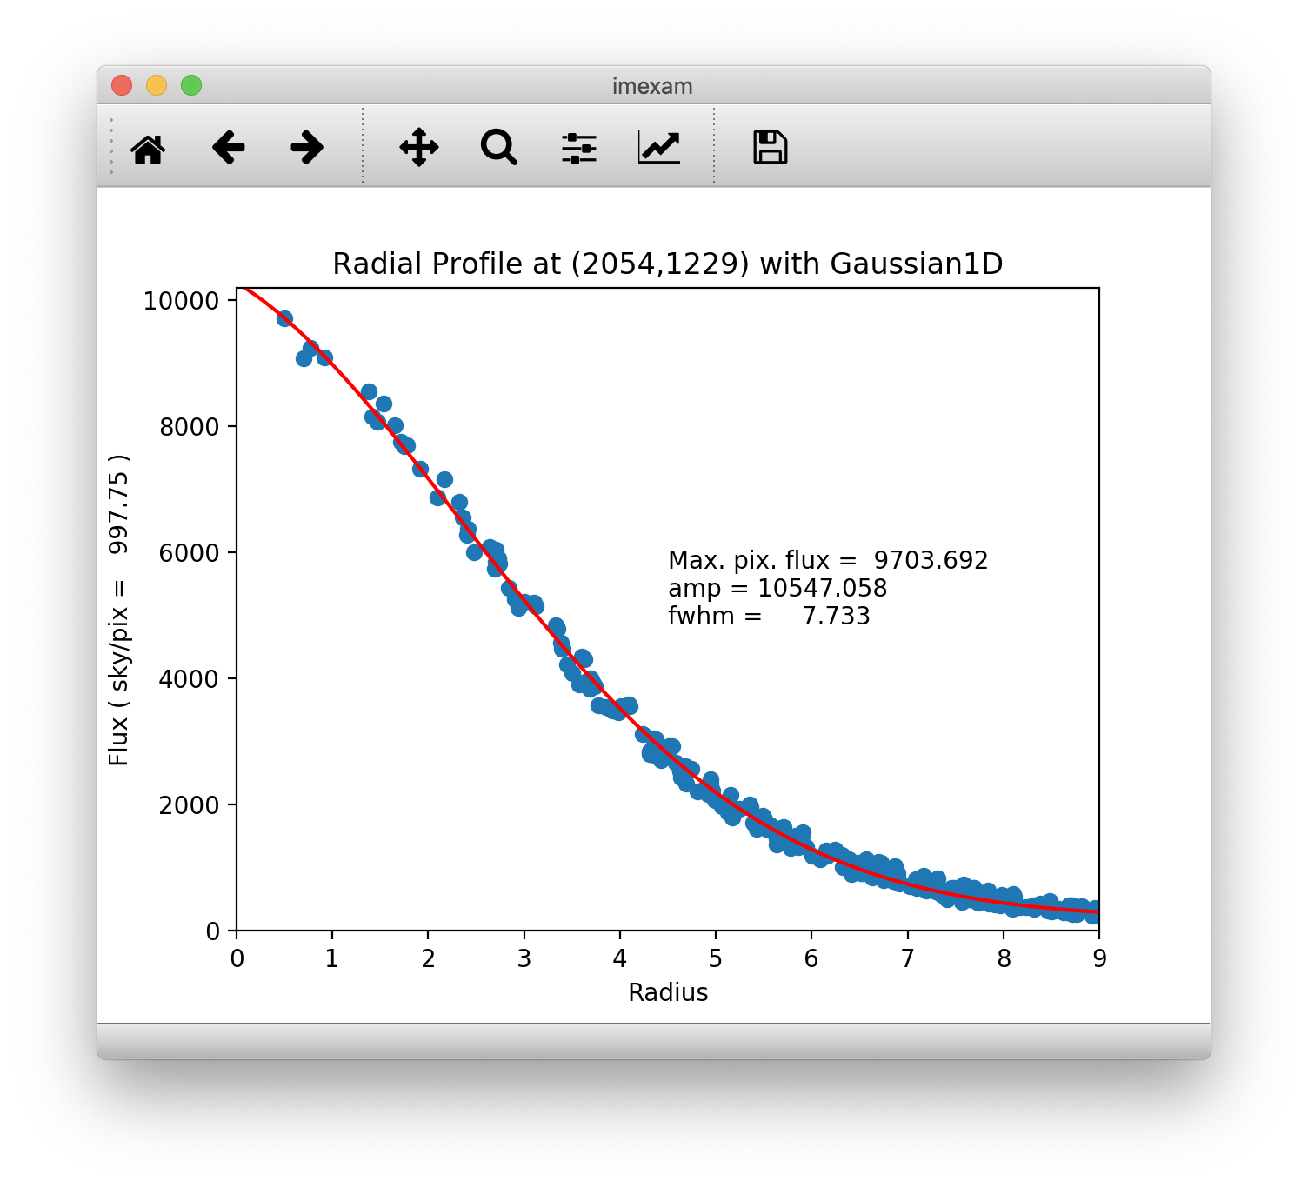
imexam
Issues and Limitations
Under heavy development
DS9 v7.4
In [1]: import imexam
In [2]:
In [2]: w = imexam.connect()
In [3]: w.load_fits("data/simple_image.fits")
In [4]: w.imexam()
Press R
Radial Profile

Slide 34
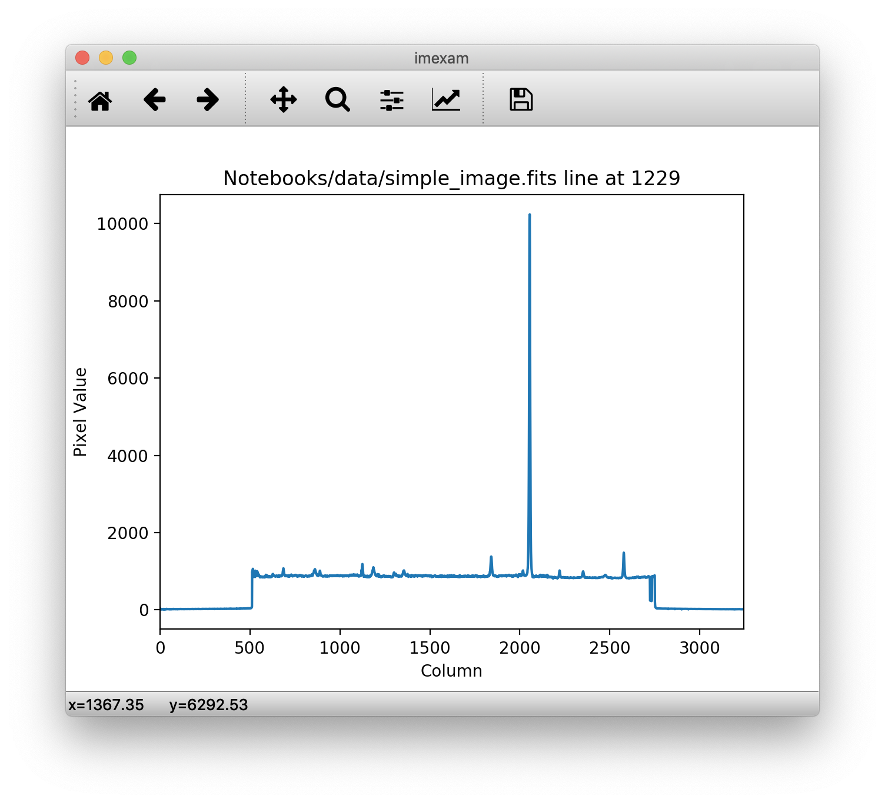
imexam
Issues and Limitations
Under heavy development
DS9 v7.4
In [1]: import imexam
In [2]:
In [2]: w = imexam.connect()
In [3]: w.load_fits("data/simple_image.fits")
In [4]: w.imexam()
Press L
Plot Line (row)

Slide 35
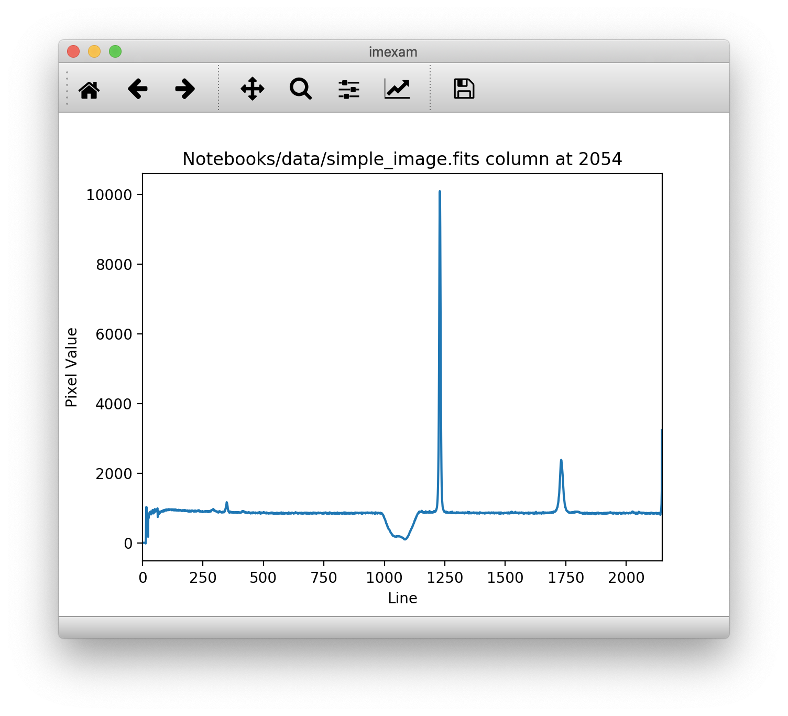
imexam
Issues and Limitations
Under heavy development
DS9 v7.4
In [1]: import imexam
In [2]:
In [2]: w = imexam.connect()
In [3]: w.load_fits("data/simple_image.fits")
In [4]: w.imexam()
Press C
Plot Column

Slide 36
imexam
Issues and Limitations
Under heavy development
DS9 v7.4
In [4]: v.imexam()
Press 'q' to quit
2 Make the next plot in a new window
a Aperture sum, with radius region_size
b Return the 2D gauss fit center of the object
…

Slide 37
photutils
photutils
DAOFind
IrafStarFind
Local density maxima with peaks above threshold;
Matching 2D Gaussian Kernel;
Kernel may be elliptical.
Implements IRAF's starfind;
Matching 2D Gaussian Kernel.
Use image moments.

Slide 38
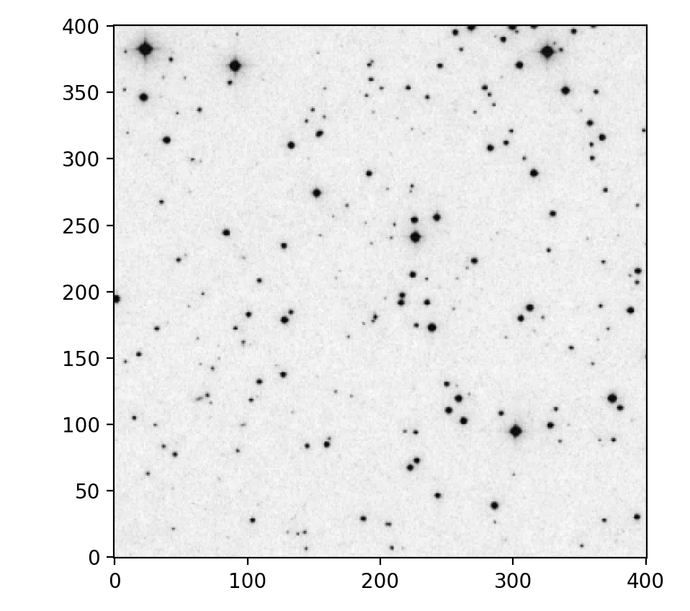
photutils
from photutils import datasets
hdu = datasets.load_star_image()
data = hdu.data[0:401, 0:401]

Slide 39
photutils
Getting Stats
from photutils import datasets
hdu = datasets.load_star_image()
data = hdu.data[0:401, 0:401]
from astropy.stats import sigma_clipped_stats
mean, median, std = sigma_clipped_stats(data, sigma=3.0)
print(mean, median, std)
3668.09661145823 3649.0 204.41388592022315

Slide 40
photutils
Detect sources with DAOFind
from photutils import DAOStarFinder
daofind = DAOStarFinder(fwhm=3.0, threshold=5.*std)
sources = daofind(data - median)
# for consistent table output
for col in sources.colnames:
sources[col].info.format = '%.8g'
print(sources)
id xcentroid ycentroid sharpness ... sky peak flux mag --- --------- --------- ---------- ... --- ---- --------- ------------
1 144.24757 6.3797904 0.58156257 ... 0 6903 5.6976747 -1.8892441
2 208.66907 6.8205805 0.48348966 ... 0 7896 6.7186388 -2.0682032
... ... ... ... ... ... ... ... ...
286 360.44533 399.52381 0.37315624 ... 0 8079 6.9203438 -2.1003192
Length = 286 rows

Slide 41
photutils
Detect sources with DAOFind
from photutils import DAOStarFinder
daofind = DAOStarFinder(fwhm=3.0, threshold=5.*std)
sources = daofind(data - median)
from photutils import CircularAperture
... # Create fig, ax and display the image first
positions = (sources['xcentroid'], sources['ycentroid'])
apertures = CircularAperture(positions, r=6.)
apertures.plot(color='red', lw=1.5, alpha=0.5, ax=ax)
plt.show()

Slide 42
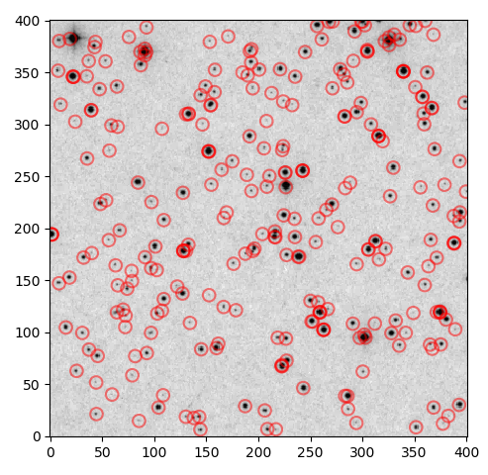
photutils
from photutils import DAOStarFinder
daofind = DAOStarFinder(fwhm=3.0, threshold=5.*std)
sources = daofind(data - median)
from photutils import CircularAperture
... # Create fig, ax and display the image first
positions = (sources['xcentroid'], sources['ycentroid'])
apertures = CircularAperture(positions, r=6.)
apertures.plot(color='red', lw=1.5, alpha=0.5, ax=ax)
plt.show()

Slide 43
photutils
Detect sources with IRAFStarFinder
from photutils import IRAFStarFinder
iraffind = IRAFStarFinder (fwhm=3.0, threshold=5.*std)
iraf_sources = iraffind(data - median)
... # Create fig, ax and display the image first
iraf_pos = (sources['xcentroid'], sources['ycentroid'])
iraf_ap = CircularAperture(iraf_pos, r=4.)
iraf_ap.plot(color='blue', lw=1.5, alpha=0.5, ax=ax)
plt.show()

Slide 44
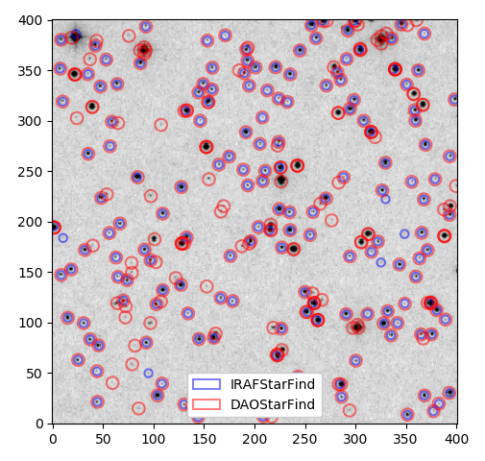
photutils
Detect sources with IRAFStarFinder
from photutils import IRAFStarFinder
iraffind = IRAFStarFinder (fwhm=3.0, threshold=5.*std)
iraf_sources = iraffind(data - median)
... # Create fig, ax and display the image first
iraf_pos = (sources['xcentroid'], sources['ycentroid'])
iraf_ap = CircularAperture(iraf_pos, r=4.)
iraf_ap.plot(color='blue', lw=1.5, alpha=0.5, ax=ax)
plt.show()

Slide 45
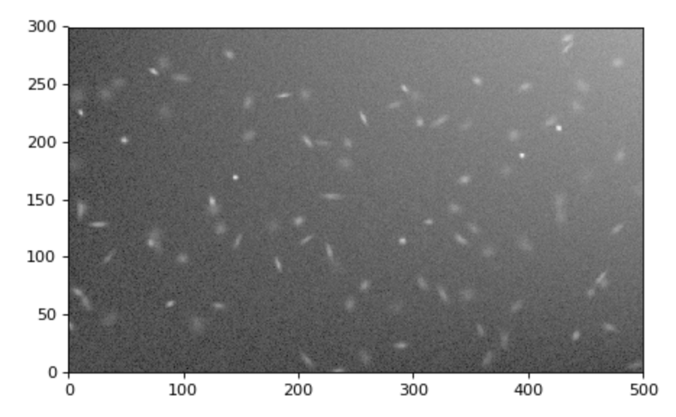
photutils
2D Background Subtraction

Slide 46
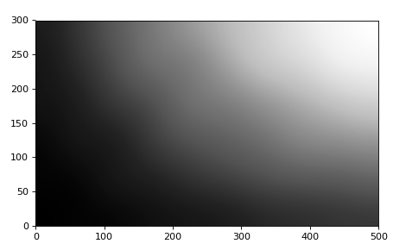
photutils
2D Background Subtraction

Slide 47
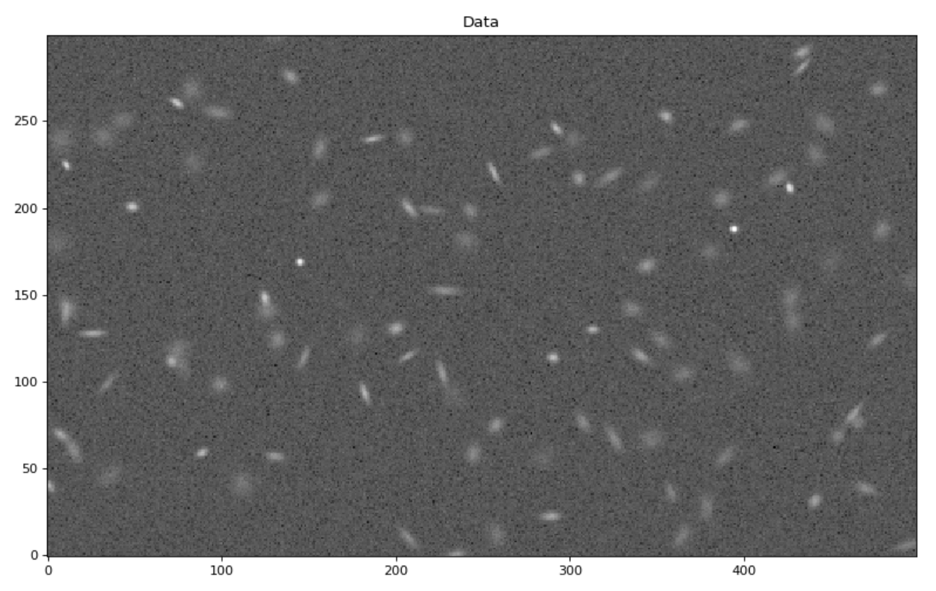
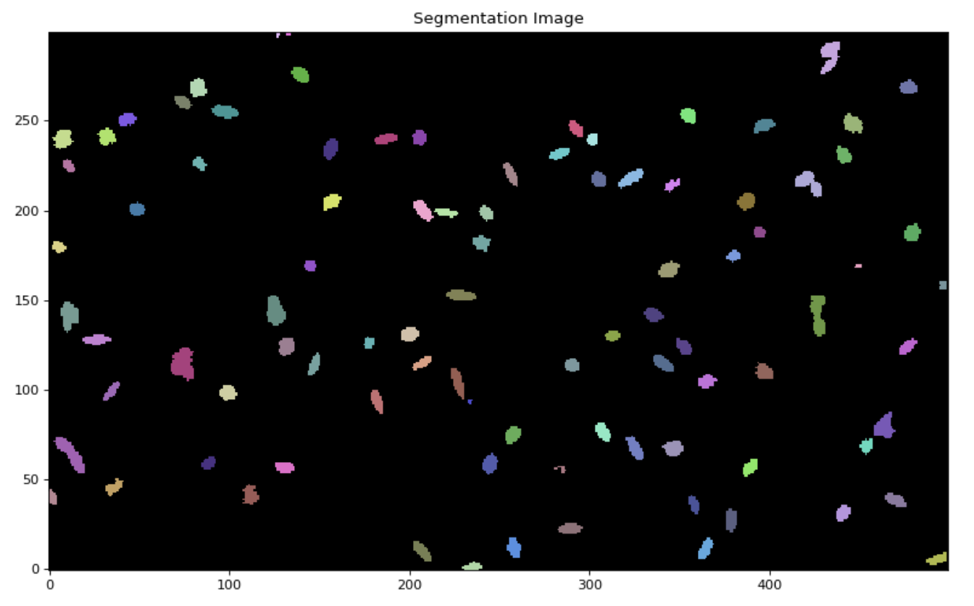
photutils
Image Segmentation

Slide 48
Getting Help
Official Documentation
https://www.astropy.org/
Channels on Slack
astropy.slack.com
AstroPy on GitHub
https://github.com/astropy/astropy/issues

Slide 49

Questions?

